Slide 1
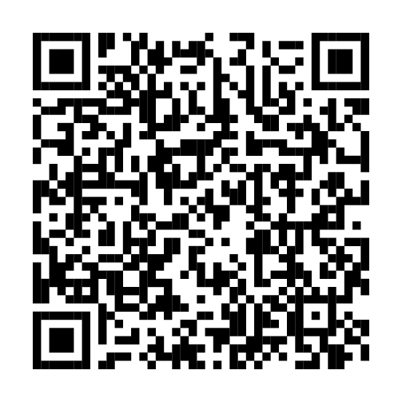
Managing your benefits is even easier
Your health and insurance benefits are at Fidelity
You can now manage your health, insurance, and retirement benefits in one place—through NetBenefits®.
Scan code or visit www.NetBenefits.com/healthbenefits to review your benefits.
Fidelity Brokerage Services LLC, Member NYSE, SIPC, 900 Salem Street, Smithfield, RI 02917 © 2025 FMR LLC. All rights reserved. XXXXXX.X.0
CLIENT LOGO
The trademarks and/or service marks appearing above are the property of FMR LLC and may be registered. The Fidelity Investments and pyramid design logo is a registered service mark of FMR LLC. Fidelity Workplace Services LLC, 245 Summer Street, Boston, MA 02210. © 2025 FMR LLC. All rights reserved. 1216371.1.0

