Slide 1

Health and insurance benefits together for you
CLIENT LOGO

Slide 2

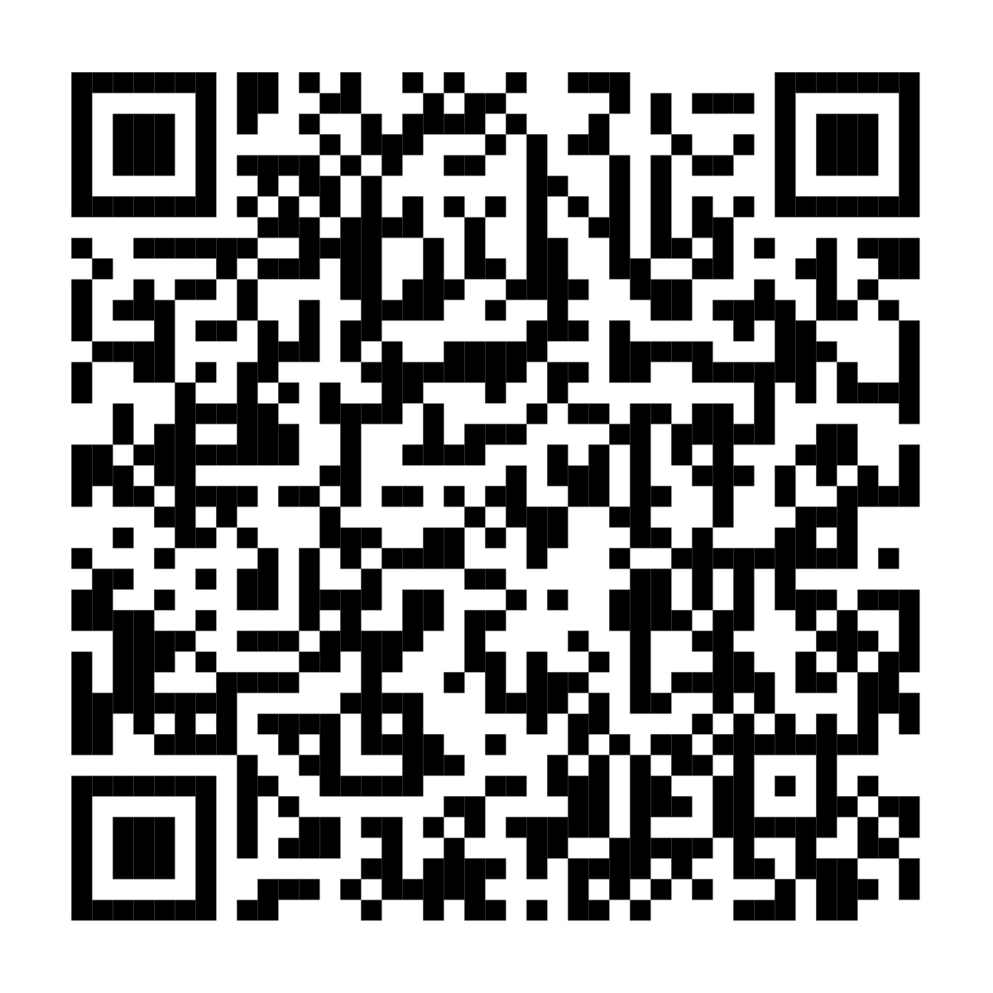
Your health and insurance benefits have moved to Fidelity
Presorted First-Class
U.S. Postage PAID
Fidelity Investments
900 Salem Street
Smithfield, RI 02917
You can now manage your health, insurance, and retirement benefits in one place — through NetBenefits®. You’ll also find personalized guidance to help you make decisions that support your total health and financial well-being.
If you have questions, please call <FIDELITY BENEFITS CENTER NAME> at <FIDELITY BENEFITS CENTER PHONE #>.
Scan code or visit www.NetBenefits.com/ healthbenefits to review your benefits.
Fidelity Workplace Services LLC, 245 Summer Street, Boston, MA 02210
© 2025 FMR LLC. All rights reserved. 1216371.1.0

