Slide 1

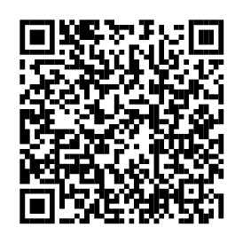
Managing your benefits is even easier
Your health and insurance benefits are at Fidelity
You can now manage your health, insurance, and retirement benefits in one place — through NetBenefits®.
Scan code or visit www.NetBenefits.com/healthbenefits to review your benefits.
The trademarks and/or service marks appearing above are the property of FMR LLC and may be registered. The Fidelity Investments and pyramid design logo is a registered service mark of FMR LLC.
Fidelity Workplace Services LLC, 245 Summer Street, Boston, MA 02210
© 2025 FMR LLC. All rights reserved. 1216371.1.0
CLIENT LOGO

