Slide 1
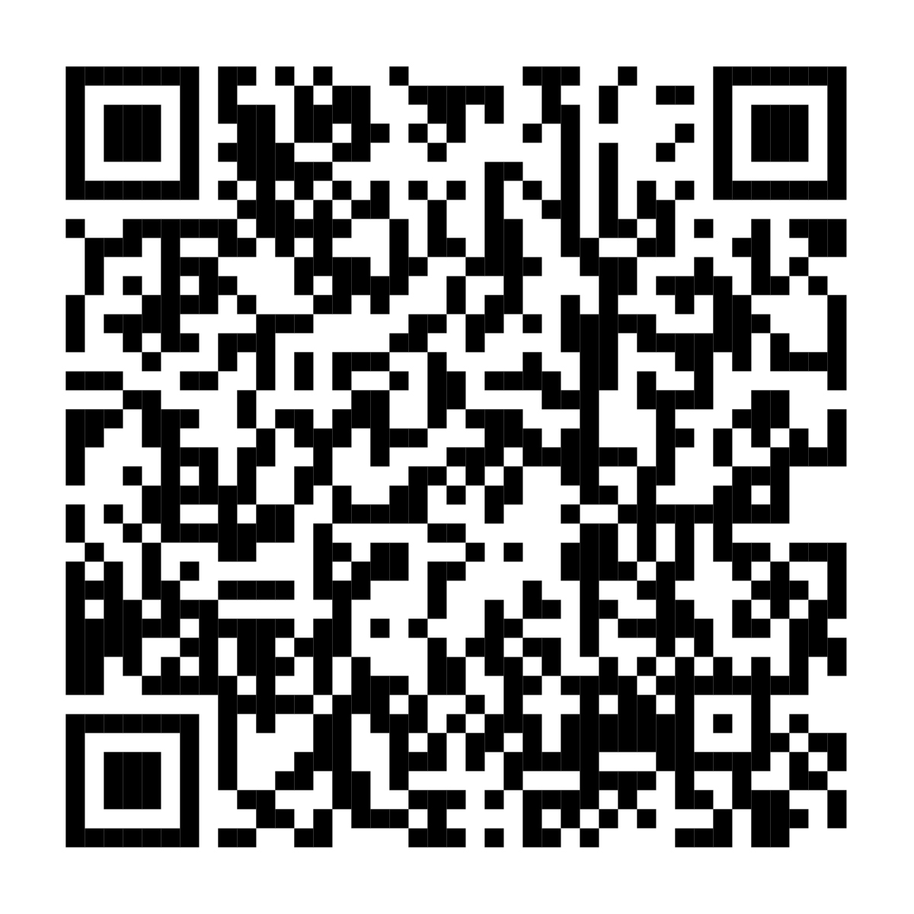
All your Annual Enrollment choices are in one place
Review your benefits selections now
Your Annual Enrollment window is <AE START DATE> until <AE END DATE>. With your Annual Enrollment at NetBenefits®, you get a
simple, guided experience to help you review, compare, and choose the options that support your total health and financial well-being.
Scan to enroll or visit www.NetBenefits.com/healthbenefits
Fidelity Brokerage Services LLC, Member NYSE, SIPC, 900 Salem Street, Smithfield, RI 02917 © 2025 FMR LLC. All rights reserved. XXXXXX.X.0
CLIENT LOGO

