Slide 1

All your Annual Enrollment choices are in one place
Review your benefits selections now
CLIENT LOGO

Slide 2

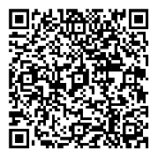
Your Annual Enrollment window is <AE START DATE>
until <AE END DATE>.
Presorted First-Class
U.S. Postage PAID
Fidelity Investments
900 Salem Street
Smithfield, RI 02917
With your Annual Enrollment at NetBenefits®, you get a simple, guided experience to help you review, compare, and choose the options that best support your total health and financial well-being.
If you have questions, please call <FIDELITY BENEFITS CENTER NAME> at <FIDELITY BENEFITS CENTER PHONE #>.
Scan to enroll or visit www.NetBenefits.com/ healthbenefits
Fidelity Workplace Services LLC, 245 Summer Street, Boston, MA 02210
© 2025 FMR LLC. All rights reserved. 1216379.1.0

