Slide 1

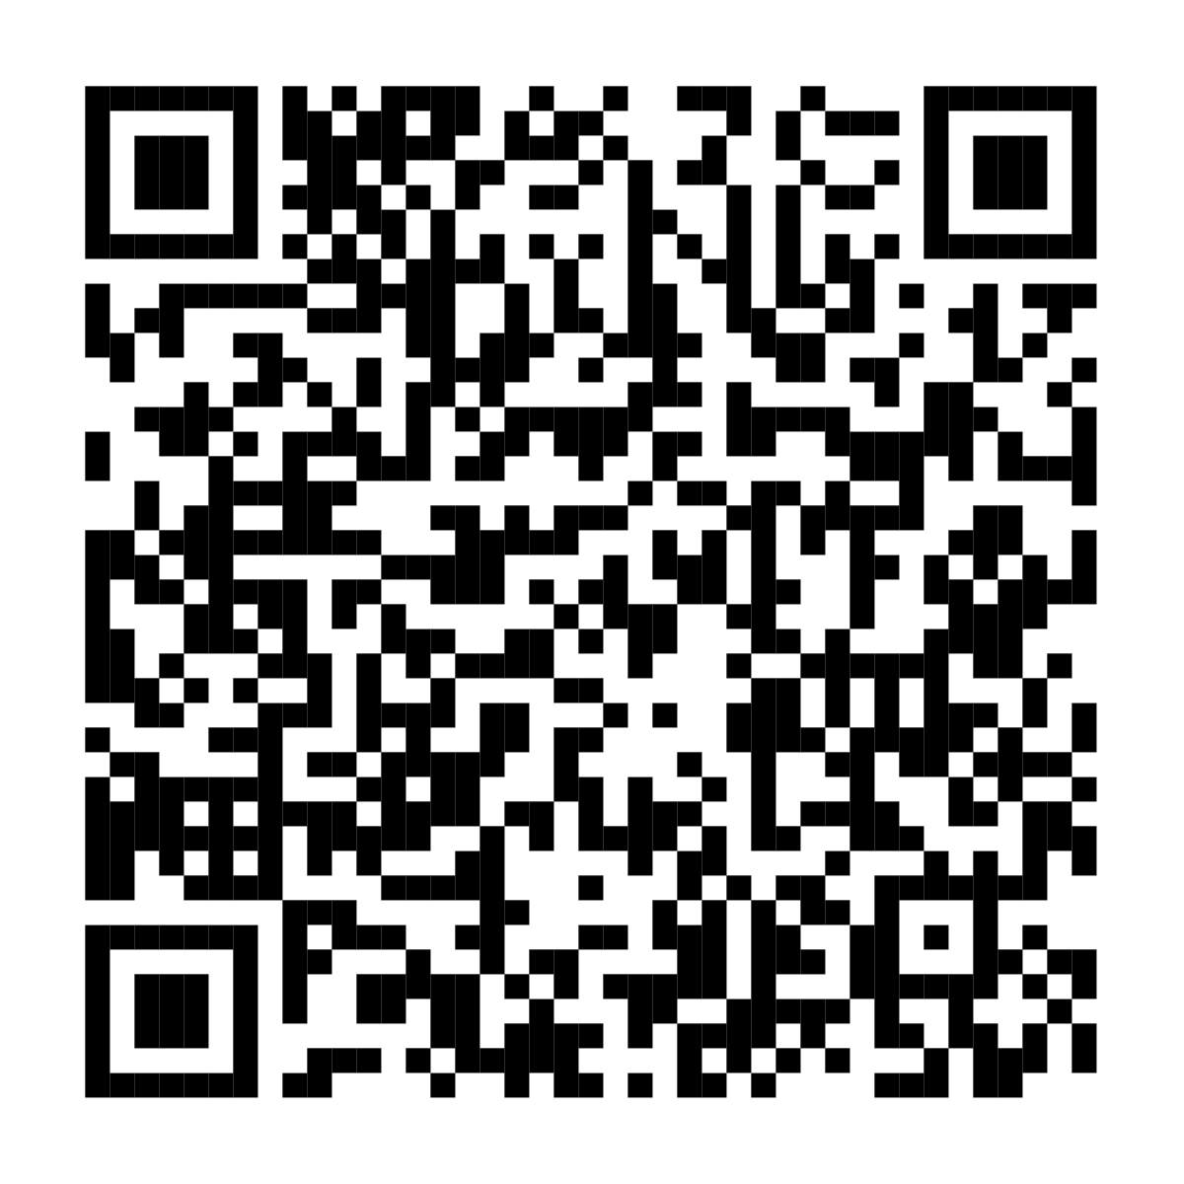

All your Annual Enrollment choices are in one place
Review your benefits selections now
Your Annual Enrollment window is <AE START DATE> until <AE END DATE>. With your Annual Enrollment at NetBenefits®, you get a simple, guided experience to help you review, compare, and choose the options that best fit your total health and financial well-being.
Scan to enroll or visit www.NetBenefits.com/healthbenefits
The trademarks and/or service marks appearing above are the property of FMR LLC and may be registered. The Fidelity Investments and pyramid design logo is a registered service mark of FMR LLC.
Fidelity Workplace Services LLC, 245 Summer Street, Boston, MA 02210
© 2025 FMR LLC. All rights reserved.1216379.1.0
CLIENT LOGO

