Slide 1

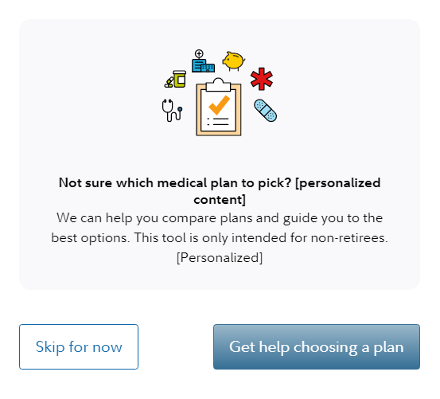
This Annual Enrollment, get help selecting the right medical plan based on what’s important to you.
Use personalized link to your enrollment page for the orange button.
Don’t forget to review and make changes to your plan during the enrollment window <insert date range>
An employee digital experience on a familiar platform that engages employees
at key enrollment periods, but also offers integration with other benefits for
ease of managing benefits.
Screenshot is for illustrative purposes only.
GET HELP CHOOSING A PLAN
For Plan Sponsor use only.
Fidelity Workplace Services LLC, 245 Summer Street, Boston, MA 02210
© 2026 FMR LLC. All rights reserved. 1041083.3.0

