Slide 1





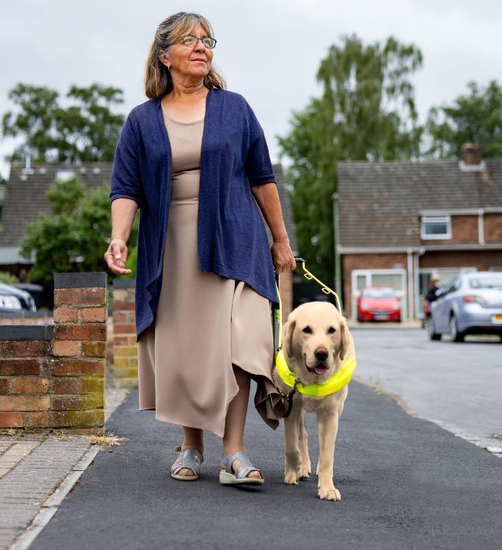
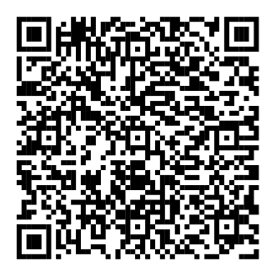
Review your plan
for everyday and unexpected expenses.
This Disability Pride Month, find education and resources tailored
to help employees with disabilities reach their financial goals and prepare for the future.
Scan the QR code or visit
Fidelity.com/DisabilityCommunityResources
Investing involves risk, including risk of loss.
The Fidelity Investments logo is a registered service mark of FMR LLC.
Fidelity Brokerage Services LLC, Member NYSE, SIPC, 900 Salem Street, Smithfield, RI 02917
© 2026 FMR LLC. All rights reserved. 1259261.1.0

