Slide 1

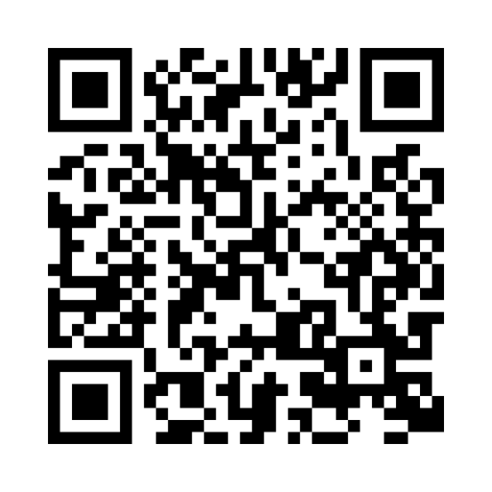

Join a live webinar with Fidelity
91% of webinar attendees
feel confident in what to do next*
Packed with financial tips, real-life scenarios, and hands-on resources, our live webinars are here to provide you with the knowledge and confidence you need to help you make informed financial decisions.
Scan this code to learn more and view upcoming events
Fidelity.com/FidelityLiveWebinars
*Fidelity Workplace Investing, Customer Experience Index Survey, feedback collected in September 2025 from webinar attendees
Investing involves risk, including risk of loss
Fidelity and the Fidelity Investments logo are registered service marks of FMR LLC.
Fidelity Brokerage Services LLC. Member NYSE, SIPC, 900 Salem Steet, Smithfield, RI 02917
© 2026 FMR LLC. All rights reserved.
1253879.1.0

