Slide 1

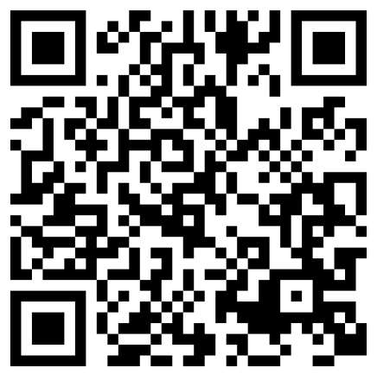
Wondering where to save vs. spend?
When you understand your paycheck, workplace benefits, and expenses, managing your saving and spending gets a little easier.
Find your way with Plan Your Pay
Scan the QR code to learn more
Check out our Plan Your Pay budgeting guideline to discover how to make the most of every dollar today and in the future.
Fidelity and the Fidelity Investments logo are registered service marks of FMR LLC.
Fidelity Brokerage Services LLC, Member NYSE, SIPC, 900 Salem Street, Smithfield, RI 02917
© 2026 FMR LLC. All rights reserved.
1274291.1.1

