Slide 1
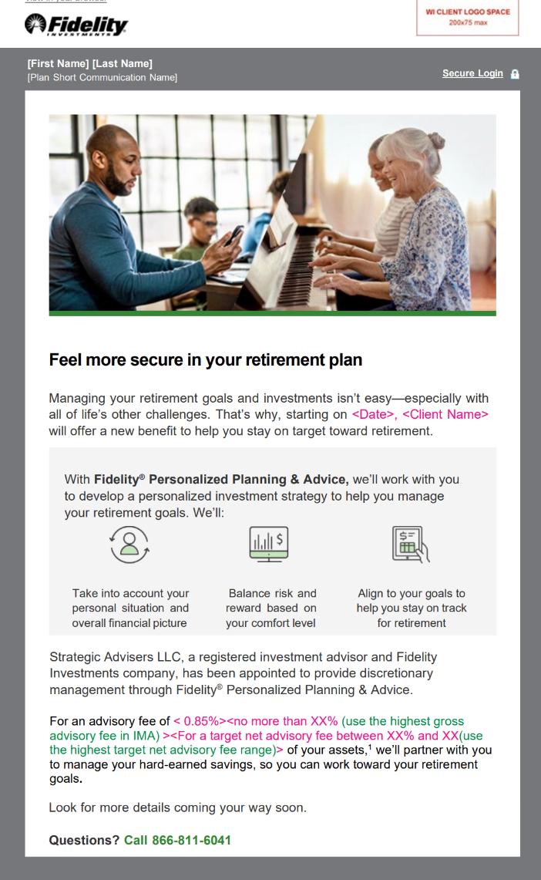
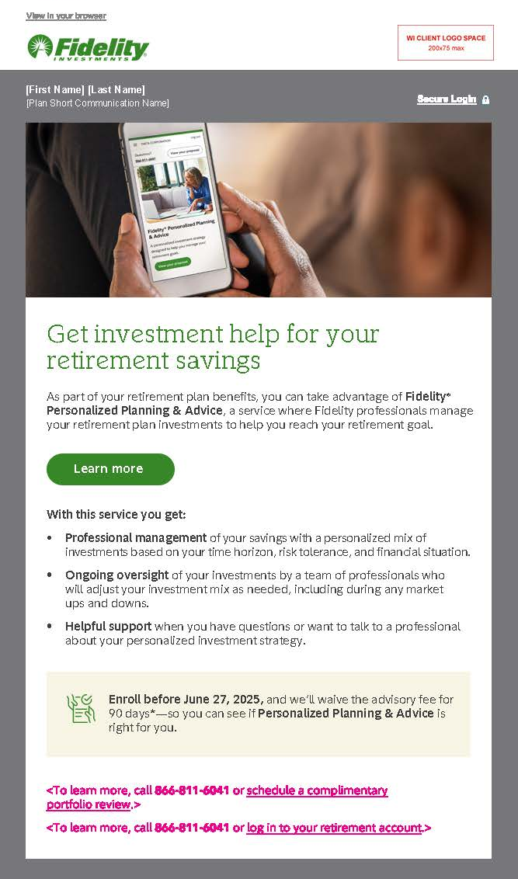
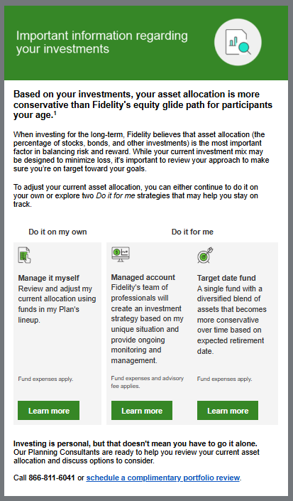
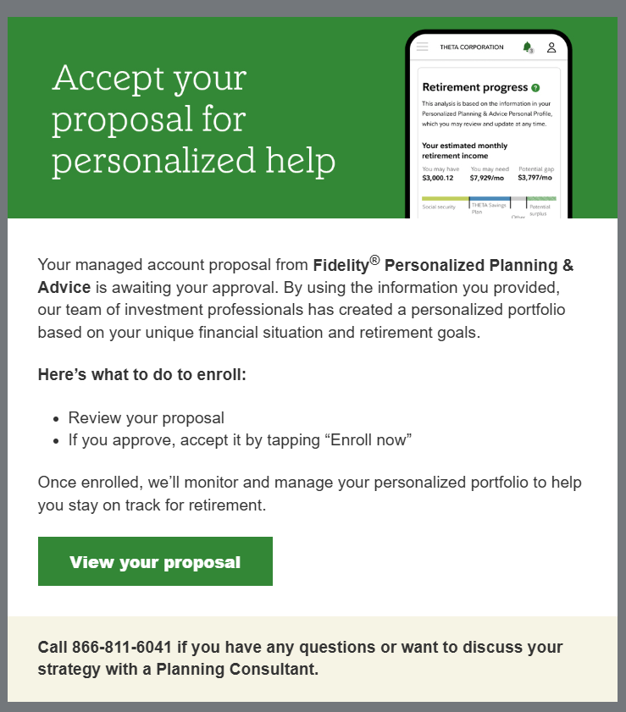
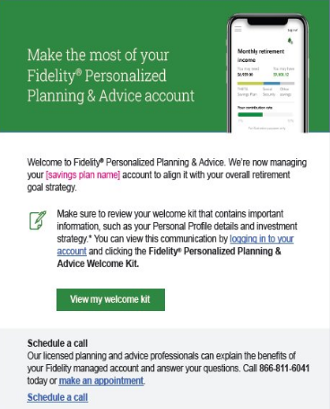
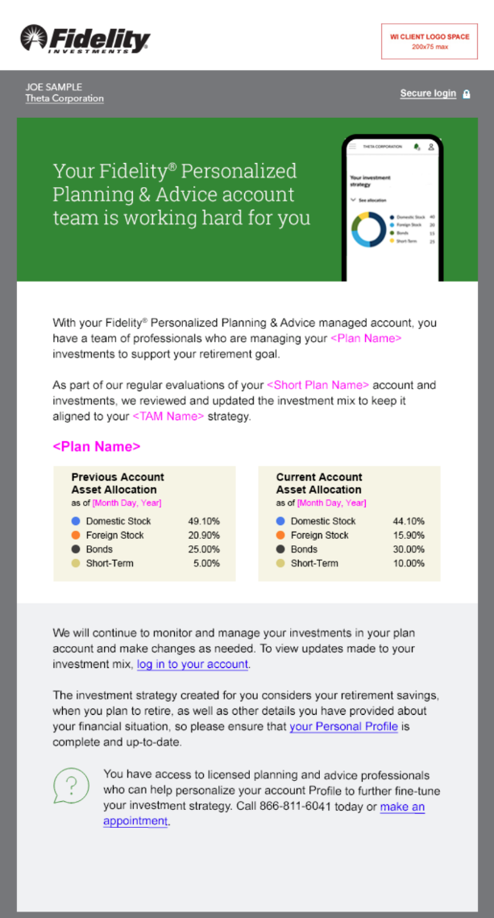
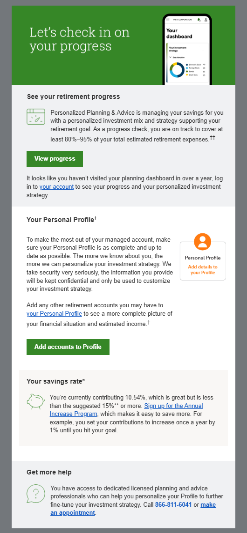
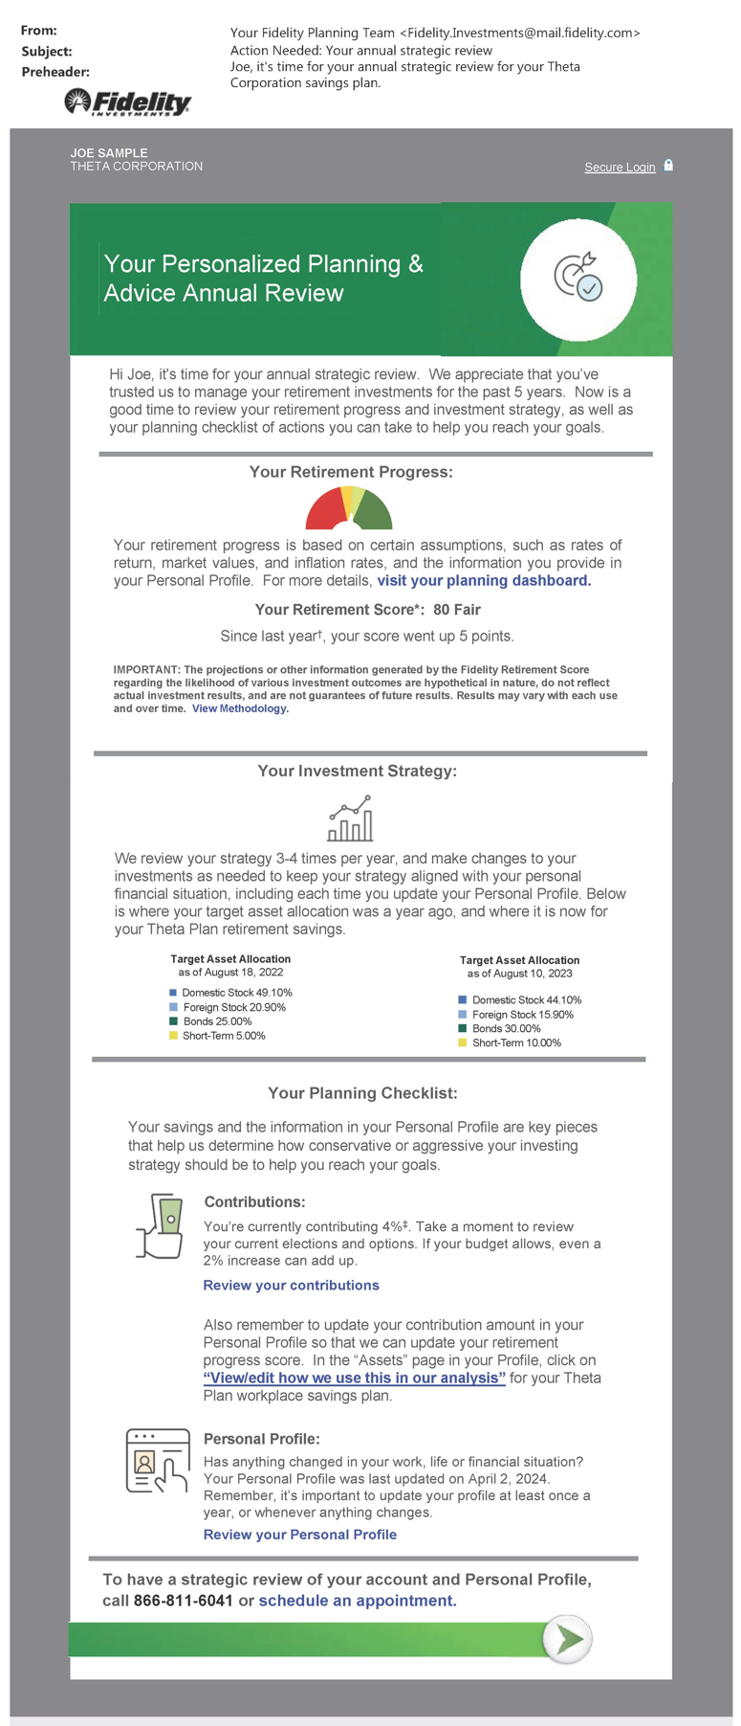
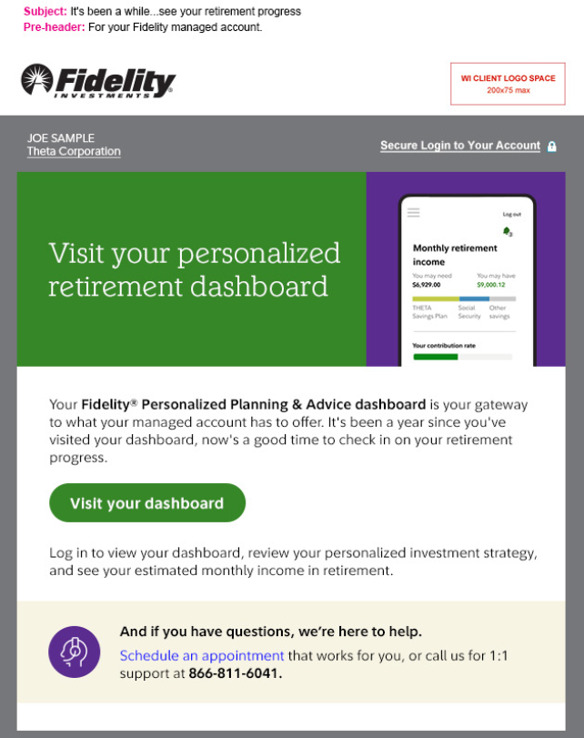
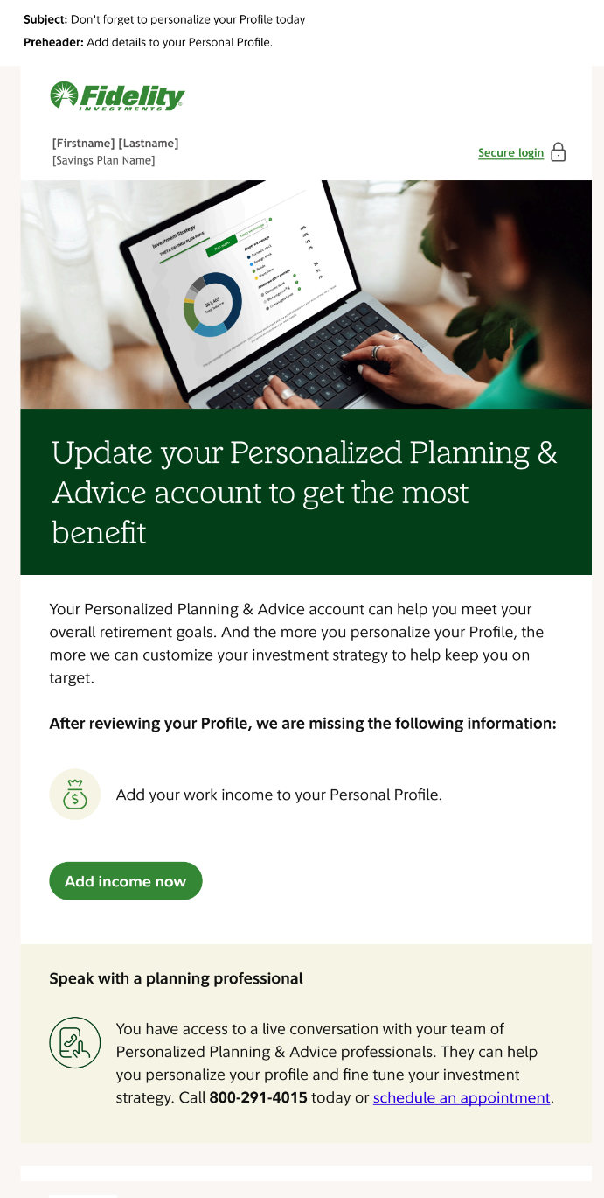
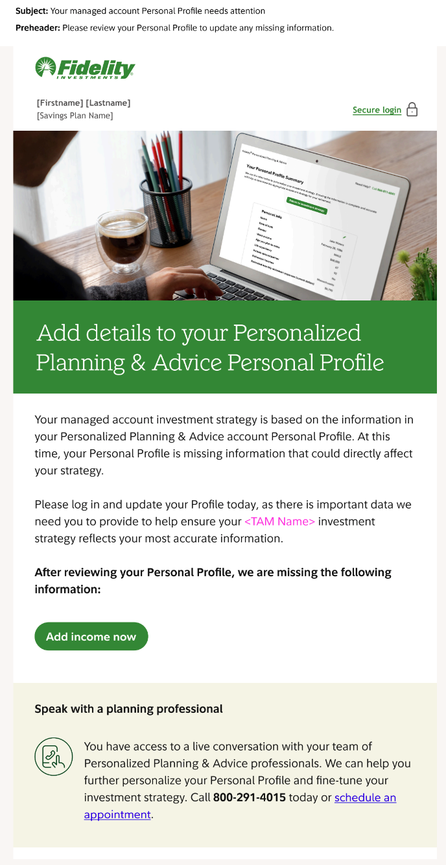
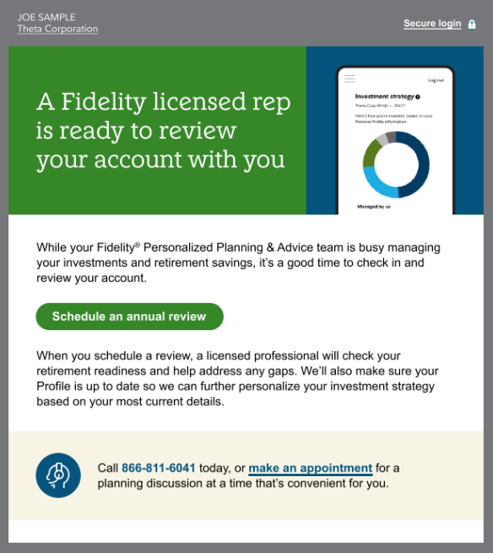
Fidelity® Personalized Planning & Advice (PP&A)
Centrally deployed campaigns
 | Eligible |  |  |  | Enrolled
 | Awareness | Consideration |  |  | Onboard | Personalize & Maximize |  |  |  |  |  | Retirement Readiness
 | Activation | PP&A Awareness | Off-Track Investment Mix (TAM) | Re-engagement | Onboarding | Investment Strategy | Quarterly Check-In | Anniversary | Engagement triggers | Personal Profile Reminders | Low Personalization Reminder | Retirement Readiness
Description | Announces the availability of the new PP&A service to plan participants after a plan adds PP&A as a plan feature | To provide awareness and education on what a managed account offers and to consider if a managed account is right for them | Notifies DIYer participants that their asset allocation is off track >25% | Re-engages participants that started their Personal Profile or generated a Proposal to return and learn more or complete their enrollment | To welcome participants and promote personalizing their Personal Profile and visiting their PP&A planning dashboard | To inform participants of their personalized investment strategy and keep them aware of any account reviews or changes as part of on-going management | To engage participants quarterly with a snapshot of their plan, drive planning dashboard visits, and helping ensure their Profile is kept up to date | To provide participants with their retirement readiness score, target asset allocation, and contribution snapshot compared to the previous year | To target and help ensure participants are engaging with and making the most of their managed account | Targets participants who have not yet personalized their Profile | Targets participants who are considered low personalized within their Personal Profile | To provides education and resources to participants supporting their saving and planning decisions as they prepare for retirement
Opt-Out Available | Yes | Yes | Yes | Yes | No | No | No | No | No | Yes | Yes | No
Format | Email, Print backup for touch 1 and 2 | Email only | Email only | Email only | Email, Print backup for touch 1 only | Email, Print backup | Email, Print backup | Email, Print backup | Email only | Email, Print backup | Email, Print backup | Email only
Time/ Cadence | ~35 prior days prior to the plan going live with PP&A | Annually | February and August trigger | Ongoing trigger | Responsive: Upon enrollment, touches sent every week | Responsive: Sent after every rescore and/or Profile update | Sends during the first month of each quarter | Responsive: Sent to all participants on their anniversaries with the service | Responsive: Sent to participants who have not visited their PP&A dashboard or updated their Personal Profile within the past year | Quarterly (March, June, September, & December) | Annual (December) | Responsive: Starting at age 50 to 65 a participant will receive an annual email
Options | 3 touches | 3 touches |  | 2 touches | N/A | N/A | N/A | N/A | N/A | N/A | N/A | N/A
For plan sponsor use only. Fidelity Brokerage Services LLC, Member NYSE, SIPC, 900 Salem Street, Smithfield, RI 02917
© 2025 FMR LLC. All rights reserved.
1220731.2.0

