Slide 1


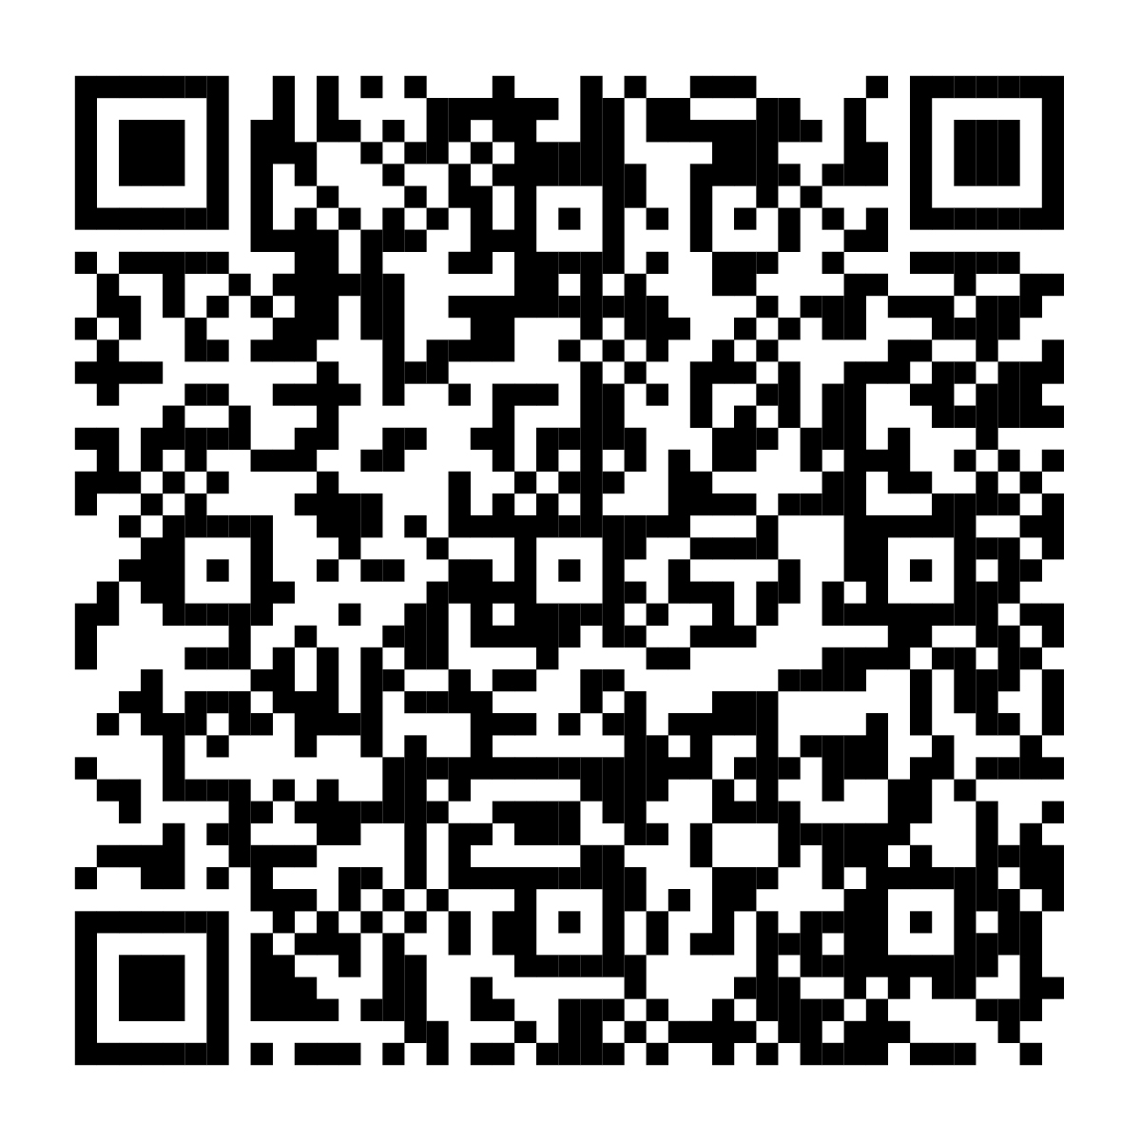
Activate your health
savings account today.
If you enrolled in the <plan name of client's HSA-eligible health plan>, don’t forget to activate your HSA to make the most of your benefits—including a contribution from your employer.
Scan this code or visit NetBenefits.com
to easily activate your HSA.
The Fidelity HSA® is offered by Fidelity Brokerage Services LLC.
Fidelity Workplace Services, LLC, 245 Summer St, Boston, MA 02210
© 2026 FMR LLC. All rights reserved.
1271485.1.0
CLIENT LOGO

