Slide 1


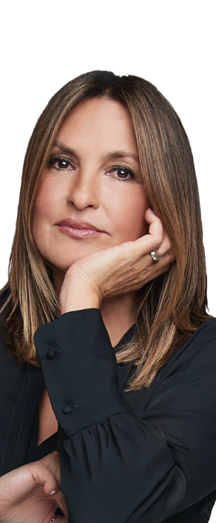
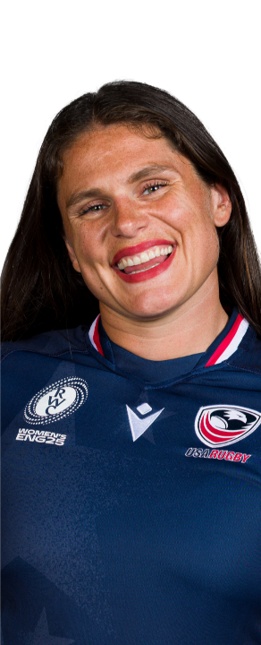
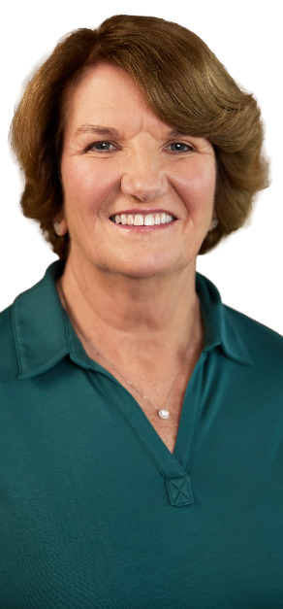
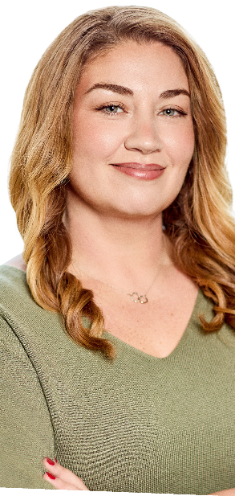
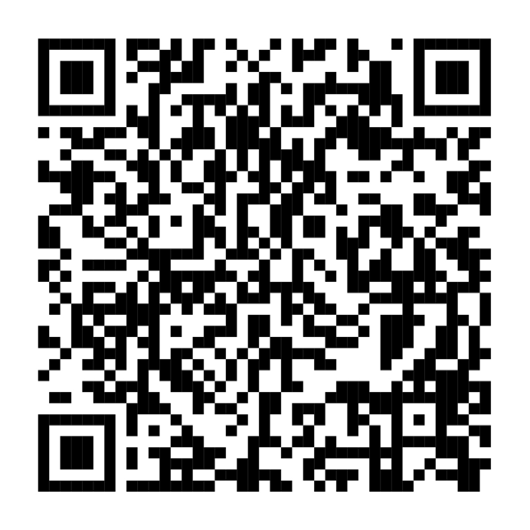
MARISKA HARGITAY
MARGARET MCKENNA
ILONA MAHER
ALEXANDRA ROCA
Fall Event Series
Virtual events starting October 14
Join special guests and Fidelity pros as they share ways to take on change and take charge of your money, career, and future.
Save your spot
Fidelity.com/FallEventSeries
Investing involves risk, including risk of loss.
The third parties mentioned herein and Fidelity Investments are independent entities and are not legally aﬃliated.
The views expressed are as of the date indicated and may change based on market or other conditions. Unless otherwise noted, the opinions provided are those of the speaker or author, as applicable, and not necessarily those of Fidelity Investments. The third-party contributors are not employed by Fidelity, and may receive compensation for their services.
Fidelity and the Fidelity Investments logo are registered service marks of FMR LLC.
Fidelity Brokerage Services LLC, Member NYSE, SIPC, 900 Salem Street, Smithﬁeld, RI 02917
© 2026 FMR LLC. All rights reserved 1268838.1.0

